Slide 1
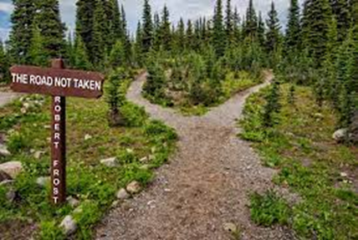
Two roads diverged in a yellow wood,
And sorry I could not travel both
And be one traveler, long I stood
And looked down as far I could
To where it bent in the undergrowth;
Then took the other….

Slide 2


Slide 3
Questions to be answered?
Is the problem solver guaranteed a solution?
Will the search terminate or get caught in an infinite loop?
Will the solution be optimal?
What are the time and memory usage complexity?

Slide 4
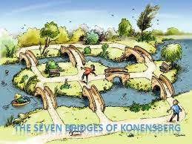
Konigsberg Bridge Problem

Slide 5
Graph Theory
Structures for State Space Search

Slide 6
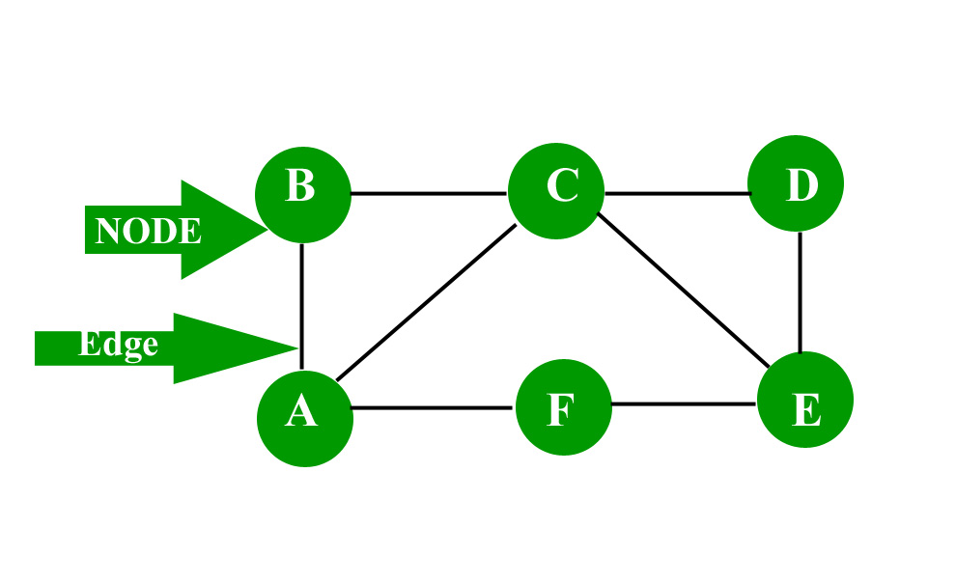
Labeled Graph
Labels on arcs
Directed graph
Path
Rooted Graph
Tree\Relation between nodes
Parent, child, siblings;
Ancestral & Descendant nodes
Leaf node

Slide 7
State Space Representation of Problems
[N, A, S, GD]
N- nodes/ states
A- Arcs/steps
S- Start node
GD- Goal State
Solution – Path from S to GD

Slide 8
State Space Representation of Tic-Tac-Toe

Slide 9

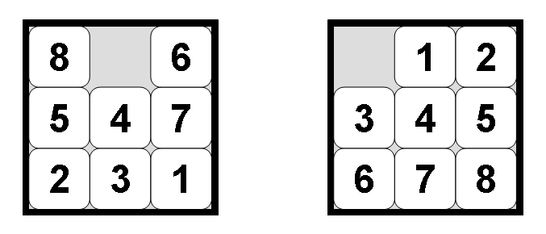
State Space Representation of 8-puzzle
Initial State
Goal State

Slide 11
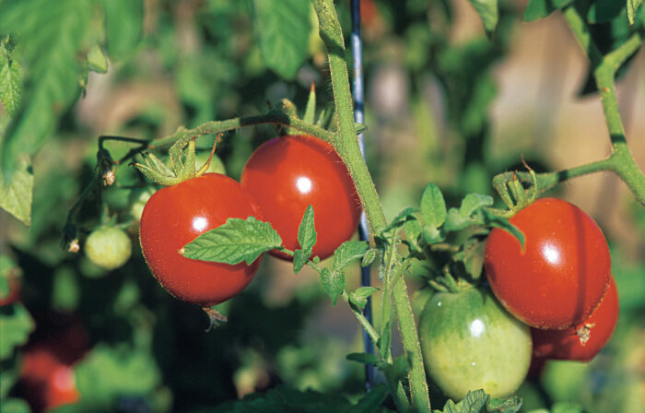
Simplifying AI Models with the PEAS Representation System
PEAS => Performance, Environment, Actuators, and Sensors.
PEAS system for a ketchup-producing industry
Agent: Tomato classification system.
Sensors: Weighing sensors, Cameras for visual input, color sensing, etc.
Actuators: Track changing mechanism for segregation, display boards, or a Y-belt for quick classification into ripe and unripe tomatoes.
Environment: Our environment can be a moving walkway through which the tomatoes are passed on for segregation. It should have a good source of light for better camera input.
Performance: It measures how successful the agent is in classifying the tomatoes. It can be a confusion matrix with true positive, true negative, false positive, and false negative numbers or the model’s accuracy.

Slide 12
Strategies for State Space Search
Data-Driven and Goal Driven Search
Graph Search
Depth-First & Breadth-First Search
Depth First with iterative Deepening

Slide 13
State Space Search
Data-Driven Search
Goal Driven Search
Data Driven approach collects the facts about the problem
Applies rules on the data and produce new facts from it to move towards the goal.
It is also termed as forward chaining.
Goal driven approach focus on the goal
Search the facts and rules that could be able to produce that goal.
It works by processing in backward direction via rules and sub goals to reach to the facts of the problem.
It is also called backward chaining.

Slide 14
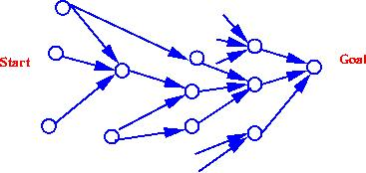
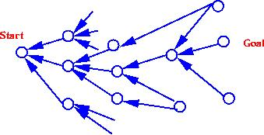
Forward Chaining.
Backward Chaining.
A goal or hypothesis is given in the problem statement
There are a large number of rules that match the facts of the problem => an increasing number of conclusions or goals
Problem data are not given but must be acquired by the problem solver
All or most of the data are given in the initial problem statement.
There are a large number of potential goals, but there are only a few ways to use the facts and given information of a particular problem instance.
It is difficult to form a goal or hypothesis.

Slide 15
Implementing Graph Search
a problem solver must find a path from a start state to a goal through the state space graph.
Backtracking is a technique for systematically trying all paths through a state space
Begins at the start state and pursues a path until it reaches either a goal or a "dead end.“
Goal ➔ it quits and returns the solution path.
Dead end ➔ "backtracks" to the most recent node on the path having unexamined siblings and continues down one of these branches,

Slide 16
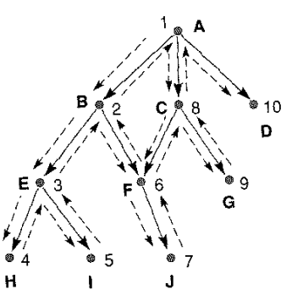
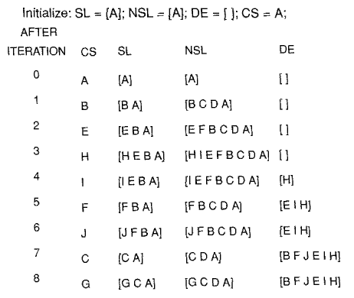
BACKTRACKING

Slide 17
Usage of Backtracking in Graph Search
I. The use of a list of unprocessed states (NSL) to allow the algorithm to return
(backtrack) to any of these states.
2. A list of “bad" states (DE) to prevent the algorithm from retrying useless paths.
3. A list of nodes (SL) on the current solution path that is returned if a goal is found.
4. Explicit checks for membership of new states in these lists to prevent looping.

Slide 18
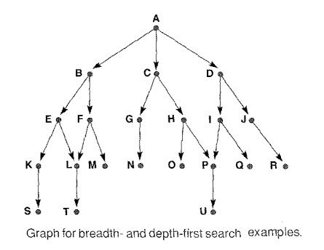
Breadth-First and Depth-First Search
BFS
DFS
OPEN
A
BCD
CDEF
DEFGH
EFGHIJ
FGHIJKL
CLOSED
A
BA
CBA
DCBA
EDCBA
OPEN
A
BCD
EFCD
KLFCD
SLFCD
CLOSED
A
BA
EBA
KEBA

Slide 19
Breadth-First and Depth-First Search
BFS
DFS
OPEN
A
BCD
CDEF
DEFGH
EFGHIJ
FGHIJKL
GHIJKLM
HIJKLMN
IJKLMNOP
JKLMNOPQ
KLMNOPQR
LMNOPQRS
MNOPQRST
NOPQRST
OPQRST
PQRST
QRSTU
RSTU
STU
TU
U
CLOSED
A
BA
CBA
DCBA
EDCBA
FEDCBA
GFEDCBA
HGFEDCBA
IHGFEDCBA
JIHGFEDCBA
KJIHGFEDCBA
LKJIHGFEDCBA
MLKJIHGFEDCBA
NMLKJIHGFEDCBA
ONMLKJIHGFEDCBA
PONMLKJIHGFEDCBA
QPONMLKJIHGFEDCBA
RQPONMLKJIHGFEDCBA
SRQPONMLKJIHGFEDCBA
TSRQPONMLKJIHGFEDCBA
OPEN
A
BCD
EFCD
KLFCD
SLFCD
LFCD
TFCD
FCD
MCD
CD
GHD
NHD
HD
OPD
PD
UD
D
IJ
QJ
J
R
CLOSED
A
BA
EBA
KEBA
SKEBA
LSKEBA
TLSKEBA
FTLSKEBA
MFTLSKEBA
CMFTLSKEBA
GCMFTLSKEBA
NGCMFTLSKEBA
HNGCMFTLSKEBA
OHNGCMFTLSKEBA
POHNGCMFTLSKEBA
UPOHNGCMFTLSKEBA
DUPOHNGCMFTLSKEBA
IDUPOHNGCMFTLSKEBA
QIDUPOHNGCMFTLSKEBA
JQIDUPOHNGCMFTLSKEBA

Slide 20
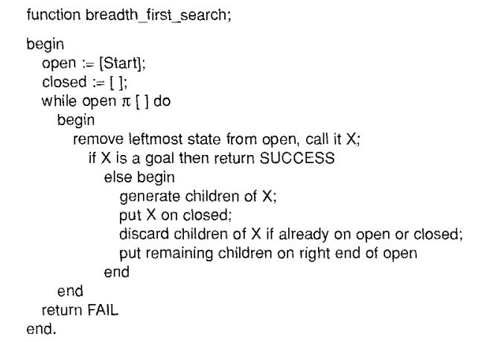
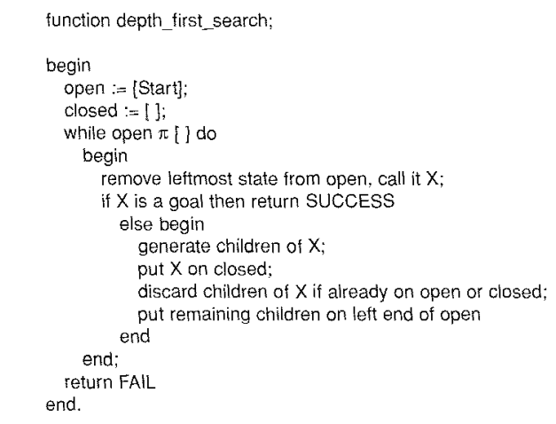
Breadth-First and Depth-First Search

Slide 21
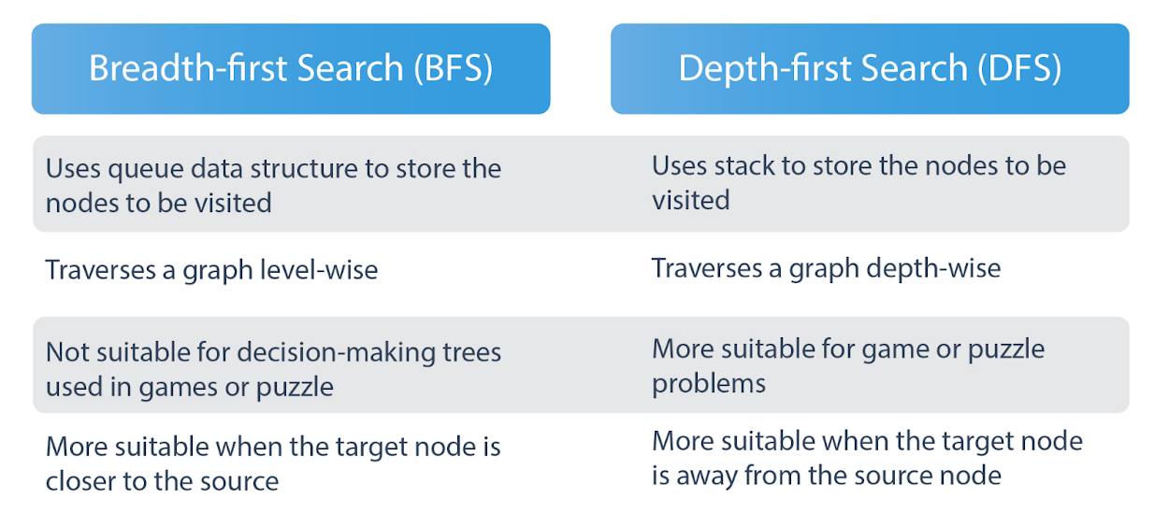

Slide 22
DFS or Depth First Search
BFS (Breadth First Search)
On unweighted graph, DFS will create minimum spanning tree for all pair shortest path tree
We can detect cycles in a graph using DFS.
Using DFS we can find path between two given vertices u and v.
We can perform topological sorting is used to scheduling jobs from given dependencies among jobs.
Using DFS, we can find strongly connected components of a graph. If there is a path from each vertex to every other vertex, that is strongly connected.
In peer-to-peer network like bit-torrent, BFS is used to find all neighbor nodes
Search engine crawlers are used BFS to build index. Starting from source page, it finds all links in it to get new pages
Using GPS navigation system BFS is used to find neighboring places.
In networking, when we want to broadcast some packets, we use the BFS algorithm.
Path finding algorithm is based on BFS or DFS.
BFS is used in Ford-Fulkerson algorithm to find maximum flow in a network.

Slide 23
Iterative deepening search
Use DFS as a subroutine
Check the root
Do a DFS searching for a path of length 1
If there is no path of length 1, do a DFS searching for a path of length 2
If there is no path of length 2, do a DFS searching for a path of length 3…

Slide 24
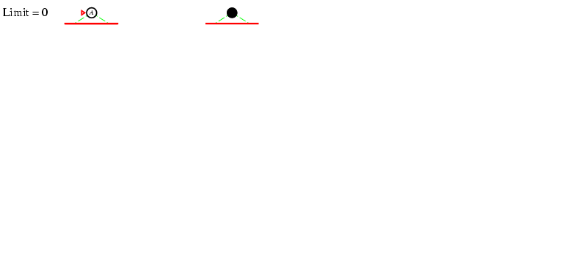
Iterative deepening search

Slide 25
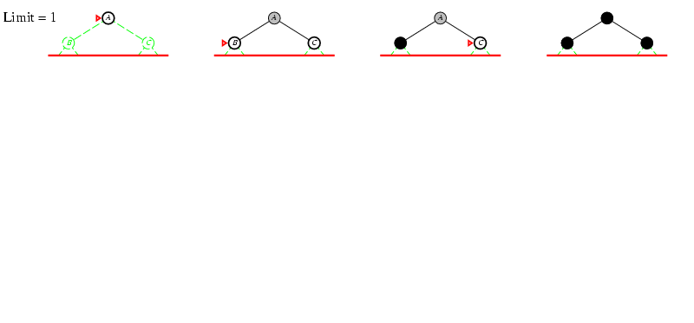
Iterative deepening search

Slide 26
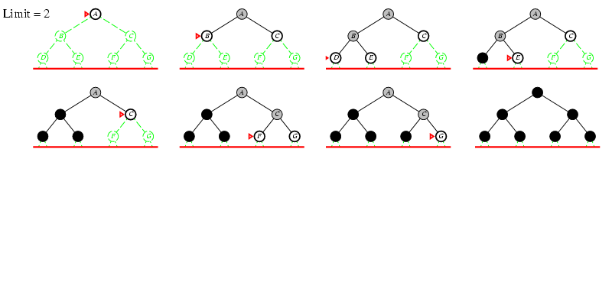
Iterative deepening search

Slide 27
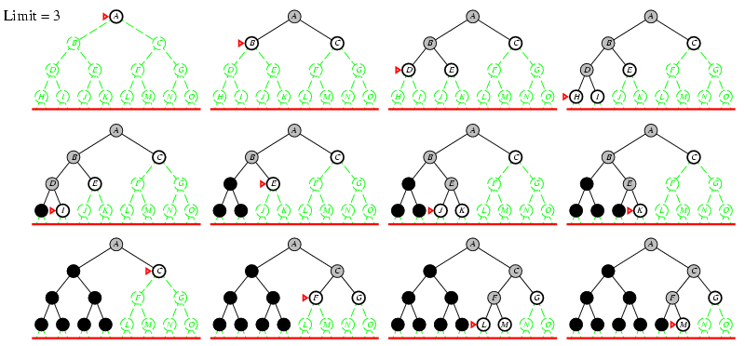
Iterative deepening search

Slide 28
Start
C
A
D
B
E
Goal

Slide 29
Using the State Space to Represent Reasoning with the Predicate Calculus
Representation
Logical expressions as states
Inference Rules as links
Correctness
Soundness and Completeness of Predicate Calculus inference Rules guarantee the Correctness of conclusions
Theorem Proof
State space Search
Example
q → p
r → p
s → r
t → r
s → u
v →q
s
t
Nodes ➔ letters
Links ➔ Implications
Soundness is the property of only being able to prove "true" things. Completeness is the property of being able to prove all true things.

Slide 30
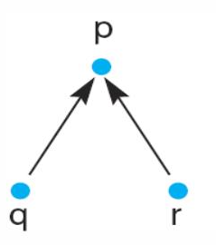
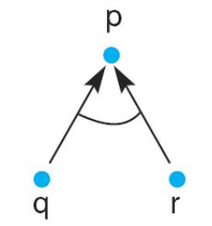
And/Or Graph
OR – Separate
AND – connected
q v r → p
q Ʌ r → p

Slide 31
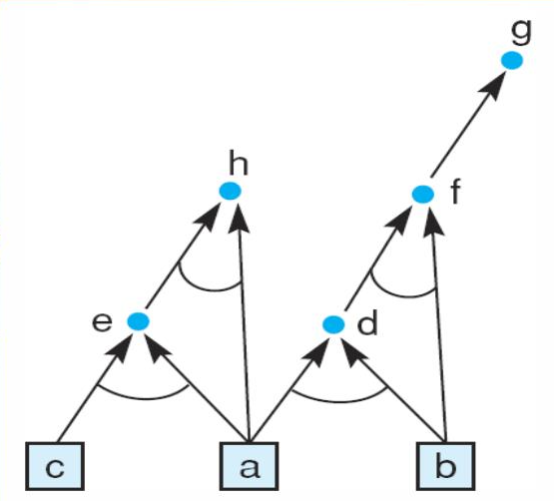
HYPERGRAPH
A hypergraph consists of :
N, a set of nodes
H, a set of hyperarcs defined by ordered pairs in which the first element of the pair is a single node from N and the second element is a subset of N
Ordinary graph – Special case of hypergraph in which all sets of descendant nodes have a cardinality of 1
k-connectors – k is the cardinality of the set of descendant nodes
Example:
a
b
c
a Ʌ b→ d
a Ʌ c→ e
b Ʌ d → f
F → g
a Ʌ e → h

Slide 32
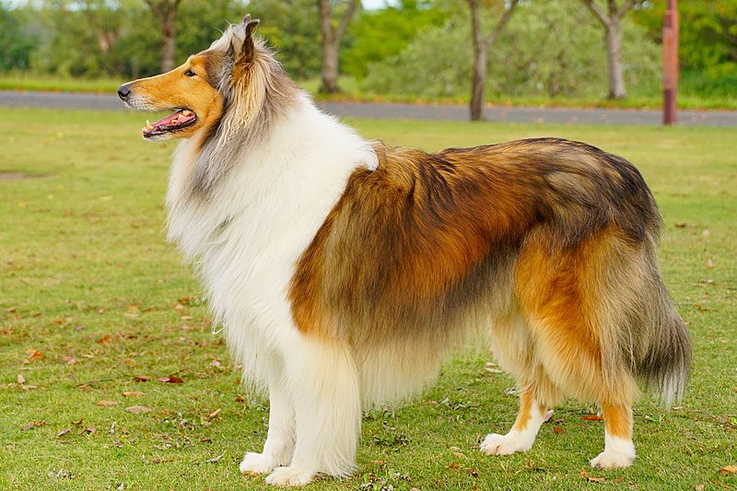
Example 1:
1. Fred is a collie. 2. Sam is Fred’s master. 3. The day is Saturday. 4. It is cold on Saturday. 5. Fred is trained. 6. Spaniels are good dogs and so are trained collies. 7. If a dog is a good dog and has a master then he will be with his master. 8. If it is Saturday and warm, then Sam is at the park. 9. If it is Saturday and not warm, then Sam is at the museum..
Draw the AND/OR graph using the data-driven strategy to find the location of fred, i.e., evaluate the goal location(fred,X).

Slide 33
Example 1:
1. Fred is a collie. 2. Sam is Fred’s master. 3. The day is Saturday. 4. It is cold on Saturday. 5. Fred is trained. 6. Spaniels are good dogs and so are trained collies. 7. If a dog is a good dog and has a master then he will be with his master. 8. If it is Saturday and warm, then Sam is at the park. 9. If it is Saturday and not warm, then Sam is at the museum..
collie(fred).
master(fred,sam).
day(saturday).
¬ (warm(saturday)).
trained(fred).
∀ X[spaniel(X) ∨ (collie(X) ∧ trained(X)) → gooddog(X)]
∀ (X,Y,Z) [gooddog(X) ∧ master(X,Y) ∧ location(Y,Z) → location(X,Z)]
(day(saturday) ∧ warm(saturday)) → location(sam,park).
(day(saturday) ∧ ¬ (warm(saturday))) → location(sam,museum).
Draw the AND/OR graph using the data-driven strategy to find the location of fred, i.e., evaluate the goal location(fred,X).

Slide 34
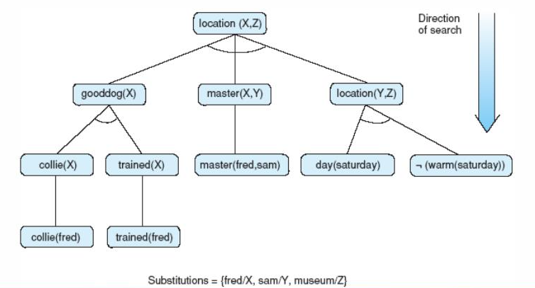
AND/OR Graph for Example 1
collie(fred).
master(fred,sam).
day(saturday).
¬ (warm(saturday)).
trained(fred).
∀ X[spaniel(X) ∨ (collie(X) ∧ trained(X)) → gooddog(X)]
∀ (X,Y,Z) [gooddog(X) ∧ master(X,Y) ∧ location(Y,Z) → location(X,Z)]
(day(saturday) ∧ warm(saturday)) → location(sam,park).
(day(saturday) ∧ ¬ (warm(saturday))) → location(sam,museum).

Slide 35
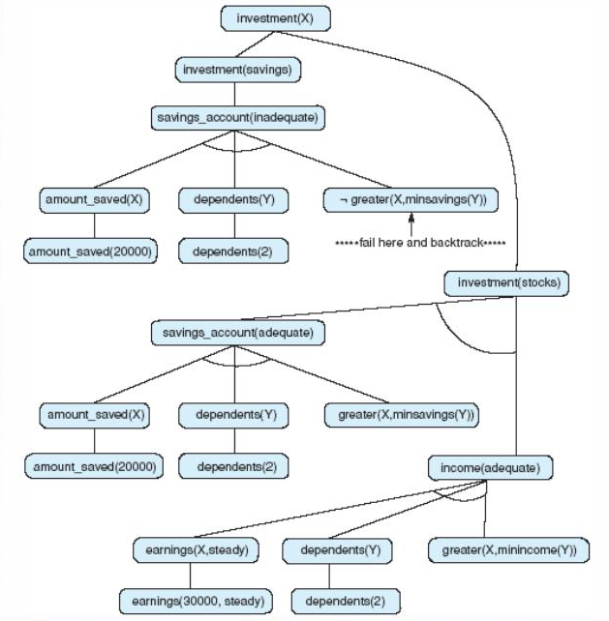
AND/OR GRAPH FOR FINANCIAL ADVISOR PROBLEM Example 2

Slide 36
WATER JUG PROBLEM
You are given two jugs, a 4-gallon one and a 3-gallon one. Neither has any measuring mark on it. There is a pump that can be used to fill the jugs with water. How can you get exactly 2 gallons of water into the 4-gallon jug?

Slide 37
